Slide 1

Artificial Intelligence in Finance An introduction to R programming
Hadi Movaghari
2022-2023
Artificial Intelligence in Finance: An introduction to R programming
University of Glasgow
2022-2023

Slide 2

Useful links
To download the latest version of R see https://cloud.r-project.org/
To see a complete list of available packages in R see https://cloud.r-project.org/web/packages/available_packages_by_name.html
A comprehensive list of packages by topics https://cloud.r-project.org/web/views/
The specific page for machine learning packages https://cloud.r-project.org/web/views/MachineLearning.html
Artificial Intelligence in Finance: An introduction to R programming
University of Glasgow
2022-2023

Slide 3
How can I use an R package?
Step 1
Installing
install.packages(“package’s name")
Step 2
Loading
library(package’s name)
Artificial Intelligence in Finance: An introduction to R programming
University of Glasgow
2022-2023

Slide 4
Preliminaries
Basic operators in R
+ | - | / | * | ^ | : | ! | ==
sum | subtraction | division | multiplication | Exponentiation | producing sequence numbers | Not | equal to
Important built-in functions in R
sqrt | log | min | max | mean | sd | abs | sum
square root | logarithm | Minimum | Maximum | average | SD. | Absolute value | Summation
Artificial Intelligence in Finance: An introduction to R programming
University of Glasgow
2022-2023

Slide 5
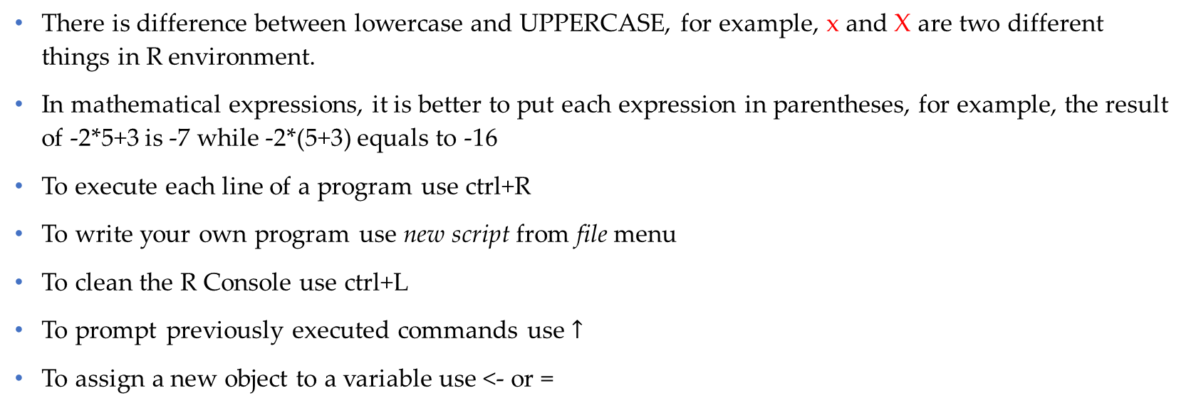
Preliminaries (Cont’d)
There is difference between lowercase and UPPERCASE, for example, x and X are two different things in R environment.
In mathematical expressions, it is better to put each expression in parentheses, for example, the result of -2*5+3 is -7 while -2*(5+3) equals to -16
To execute each line of a program use ctrl+R
To write your own program use new script from file menu
To clean the R Console use ctrl+L
To prompt previously executed commands use $↑$
To assign a new object to a variable use <- or =
Artificial Intelligence in Finance: An introduction to R programming
University of Glasgow
2022-2023

Slide 6
Objects in R
Vector
> c(1,2,3)
[1] 1 2 3
Matrix
> matrix(c(2,5,1,7), ncol=2)
[,1] [,2]
[1,] 2 1
[2,] 5 7
Data frame
> data.frame(x1=1:3, x2=2:4)
x1 x2
1 1 2
2 2 3
3 3 4
Artificial Intelligence in Finance: An introduction to R programming
University of Glasgow
2022-2023

Slide 7
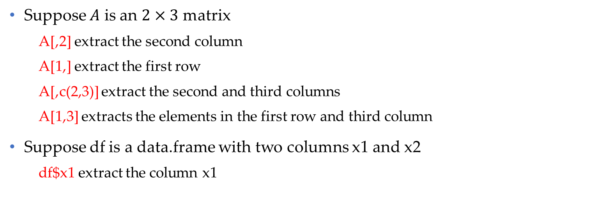
Objects in R (Cont’d)
Suppose $A$ is an $2×3$ matrix
A[,2] extract the second column
A[1,] extract the first row
A[,c(2,3)] extract the second and third columns
A[1,3] extracts the elements in the first row and third column
Suppose df is a data.frame with two columns x1 and x2
df$x1 extract the column x1
Artificial Intelligence in Finance: An introduction to R programming
University of Glasgow
2022-2023

Slide 8
Importing data into R
from Excel file
install.packages("readxl")
mydata <- read_excel(“path of the file/file name.xlsx")
from CSV file
mydata <- read.csv(“path of the file/file name.csv")
from Stata file
install.packages(“readstata13”)
mydata <- read.dta13(" path of the file/file name.dta")
Artificial Intelligence in Finance: An introduction to R programming
University of Glasgow
2022-2023

Slide 9
Some useful functions
Sequence of numbers
seq(from=2, to=10, by=3)
[1] 2 5 8
Repeating elements
rep(c("a", "b"), each=3)
[1] "a" "a" "a" "b" "b" "b"
Artificial Intelligence in Finance: An introduction to R programming
University of Glasgow
2022-2023

Slide 10
Writing a statistical model
To write a statistical mode use operator ~ in the following way:
dependent ~ independent1 + independent2
Use -1 to remove the intercept term from the model
dependent ~ independent1 + independent2 - 1
Artificial Intelligence in Finance: An introduction to R programming
University of Glasgow
2022-2023

Slide 11
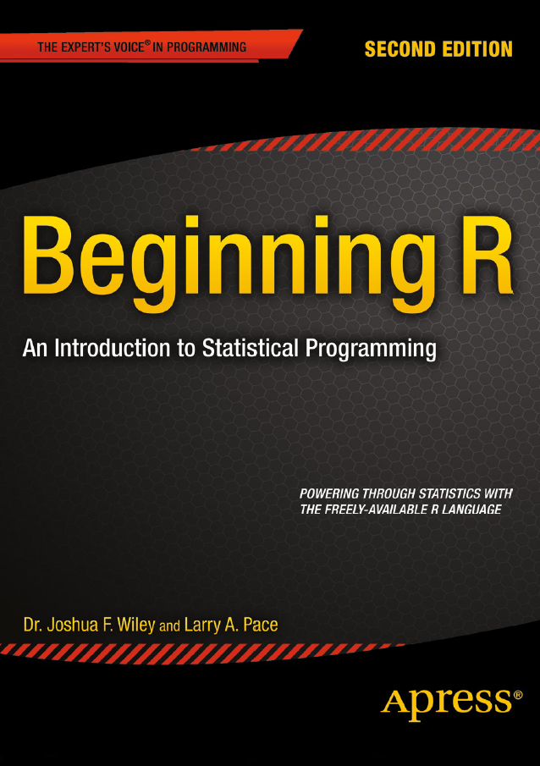


Bibliography
Available in the library
Available in the library
Artificial Intelligence in Finance: An introduction to R programming
University of Glasgow
2022-2023

